Slide 1
Al-Amal Web System
The Al-Amal Web system is considered one of the services that have been developed for the bank’s clients from legal entities, for the purpose of the entities knowing their data easily and quickly in a timely manner, such as (controlling the disbursement process, reviewing their accounts, extracting the necessary reports, as well as reviewing disbursement documents. In addition, it has been Developing the possibility of sending remittance statements by the entity after some entities request it, and in the following slides the functions of each screen will be known The system is accessed by entering the website link into one of the internet browsers to open the website and enter the login data

Slide 2
Al-Amal Web system services
Send Remittance
Dash Board
Pos Reports
Approve Send Remittance
Payment Doc.
Projects Details
Transfers Data
Balance Statement
LCLG

Slide 3
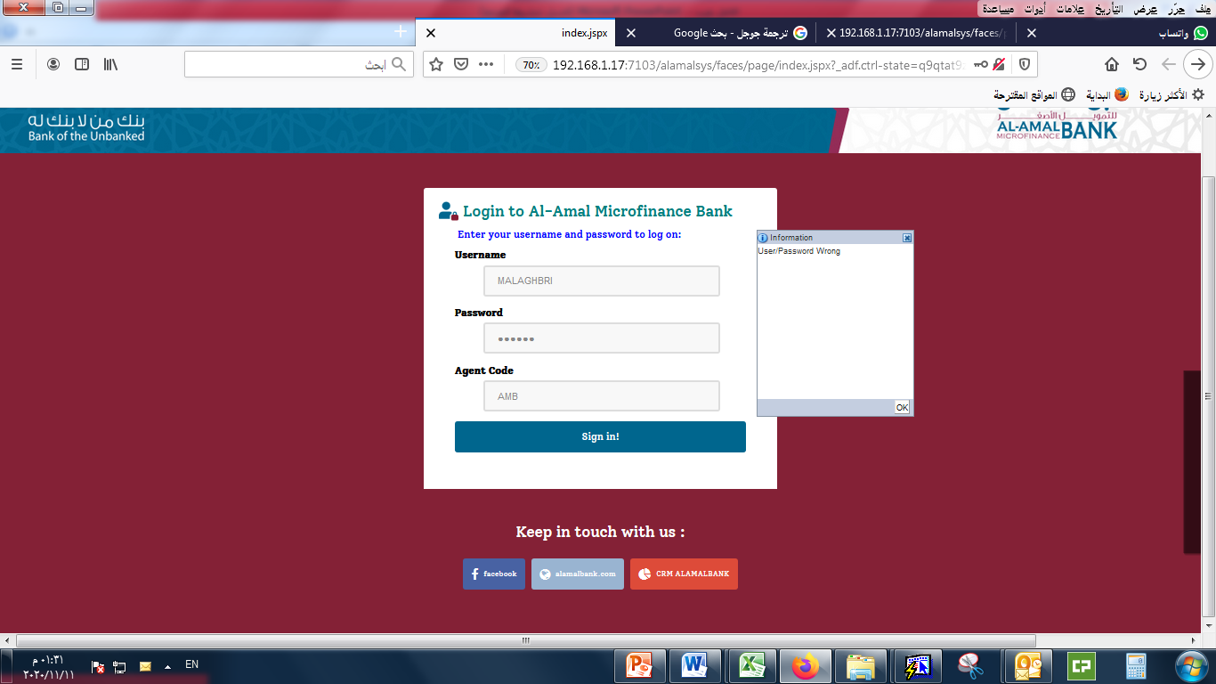
Login Page
Enter the user name
1
Enter the password
2
Enter the entity code
3
The error message is displayed if one of the fields is left blank or the login data is entered incorrectly
Click on the sign in button to log in
4

Slide 4
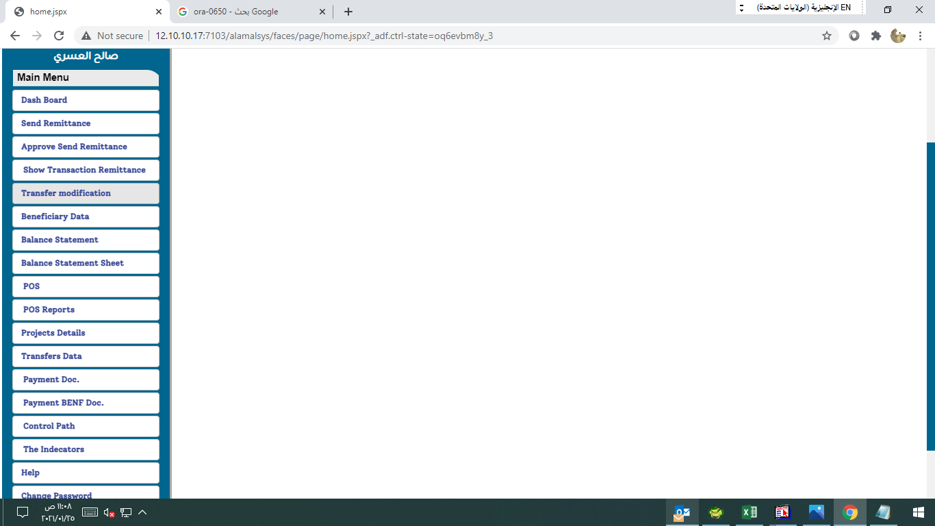
Home Page
After entering the user data and pressing the login button, you will be taken to the main page and from there enter the detailed pages according to your need, as shown in the image below.

Slide 5
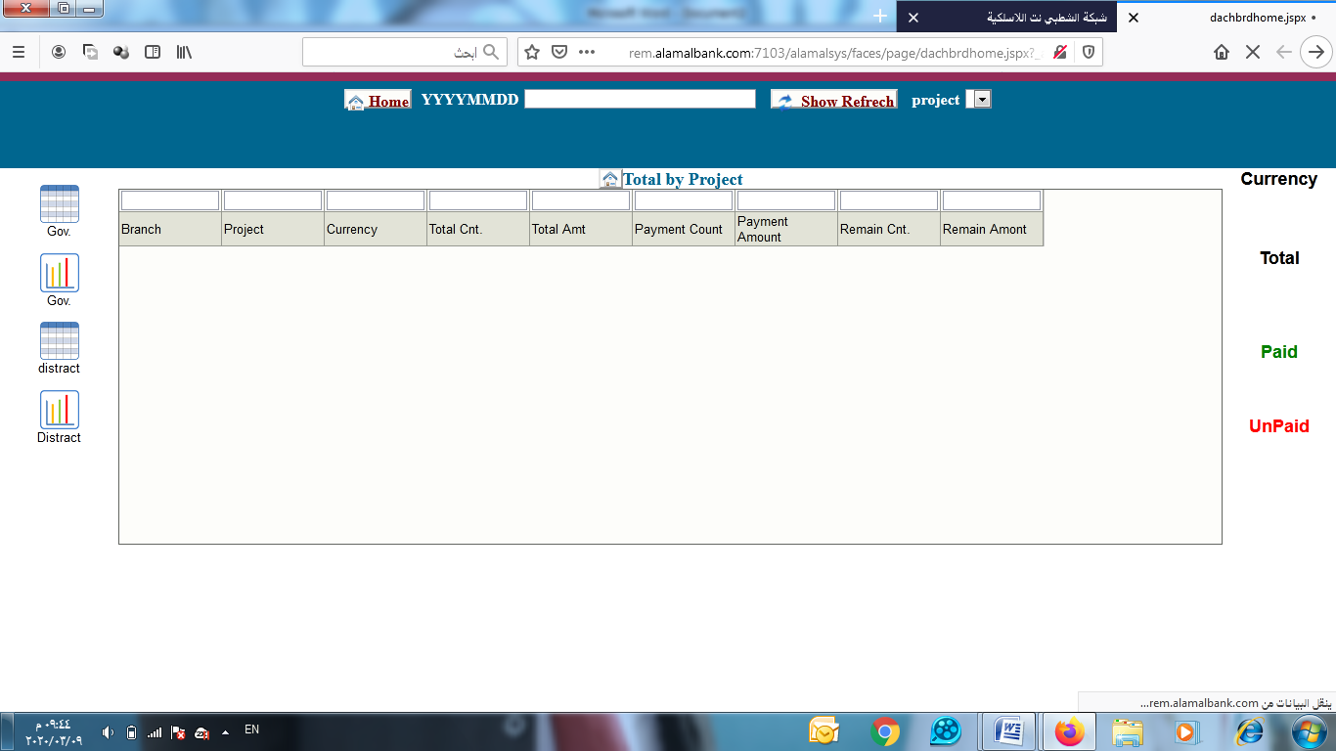
Dash Board
Specify the date on which you want to display the exchange
2
1
The project whose indicators you want to view is selected from the list
3
Click on show refresh to display the data
4
Total, Paid, and Unpaid data are displayed.

Slide 6
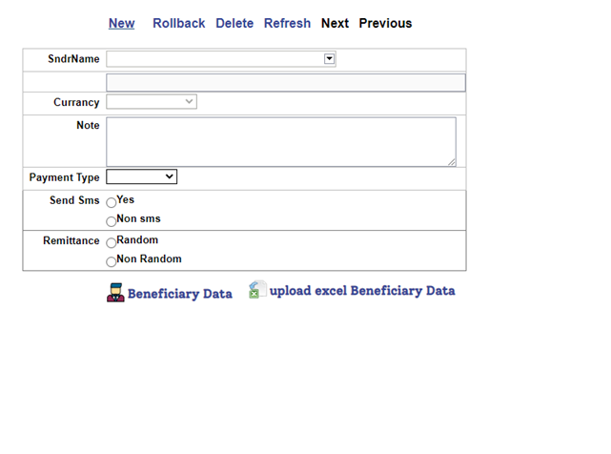
Send Remittance Page
Through this page, transfers are sent by entering the required data:
Click on the new button
1
2
Choose a project name
3
The account currency associated with the selected project is displayed
4
Determine the Payment type of (individual transfers - projects)
5
5
Click on the Beneficiary Data button to enter the transfer beneficiary data
Click on Upload Excel Beneficiary Data button to upload the names of a group of beneficiaries from Excel

Slide 7
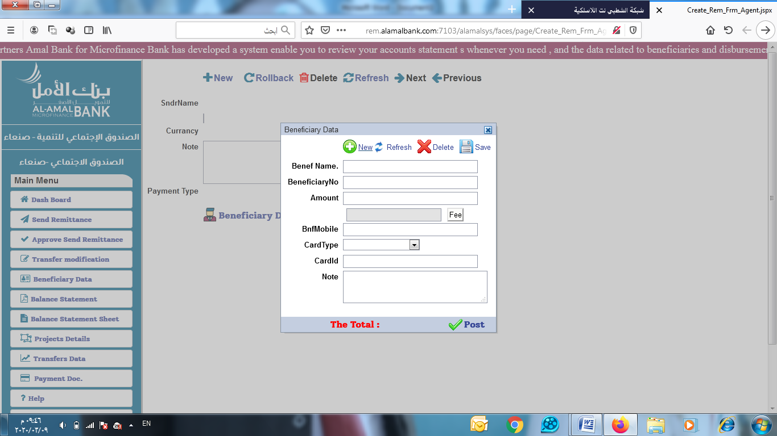
Send Remittance
(Individual)
You can enter a new transfer or delete it Data through the small screen or update the data through the buttons shown.
9
7
Click the save button
Enter beneficiary data (name - beneficiary number - amount - phone number - document type - add any note)
6
8
Click on the Post button For deportation

Slide 8
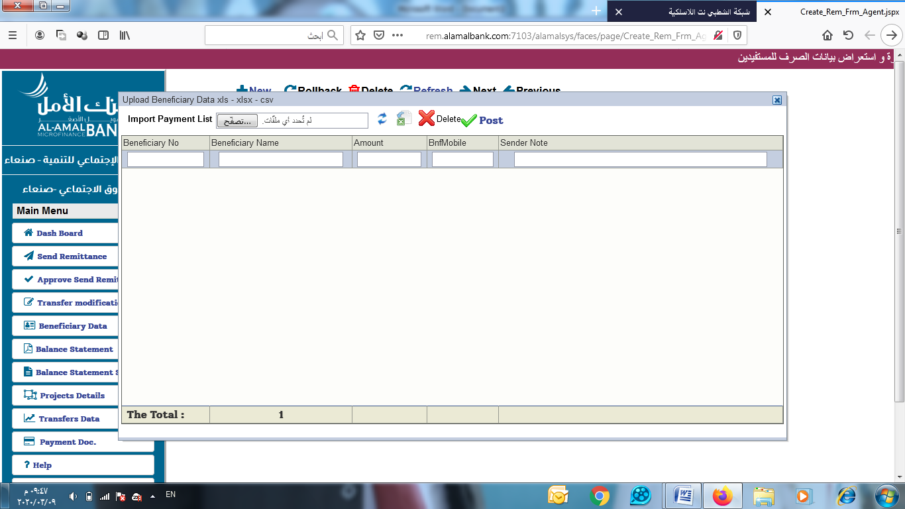
Send Remittance
(Upload Excel )
If there is a list of transfers for a group of beneficiaries, click the (Upload Excel Beneficiary Data) button, and the screen below will appear
11
Click on Post For deportation
9
Choose the excel file
Download an Excel file containing the basic data headings for entering transfers in a specific order
10
The transfers entered in Excel are displayed

Slide 9
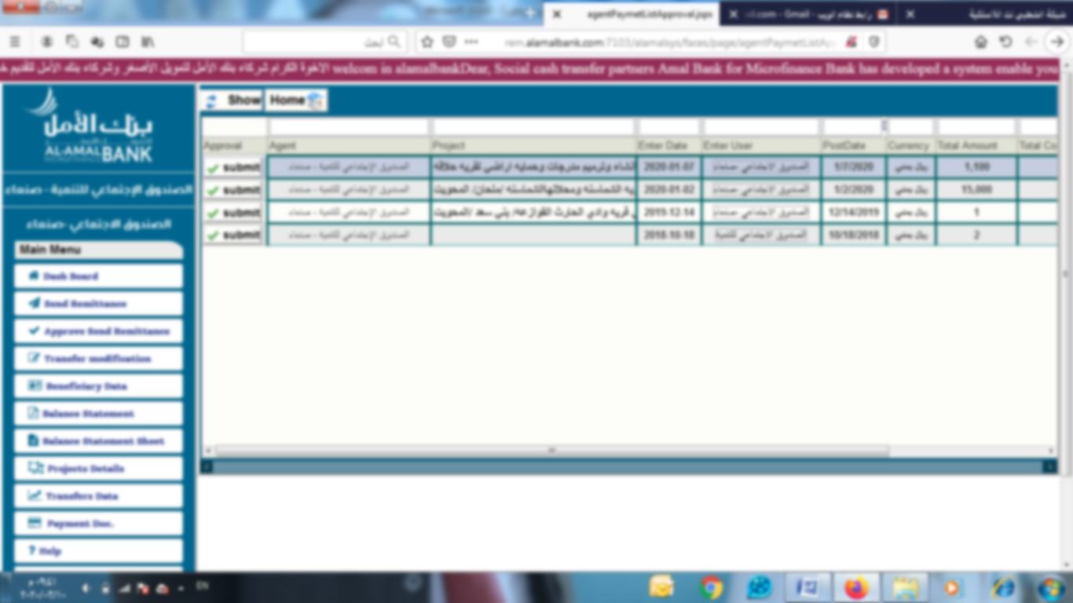
Approve Send Remittance
Through this page, the remittance entered in the previous interface
are approved to complete the transfer process:
1
Click on the show button to display all entered transfers
3
2
The total number of transfers entered for each project is displayed
Click on the submit button to approve the transfers

Slide 10
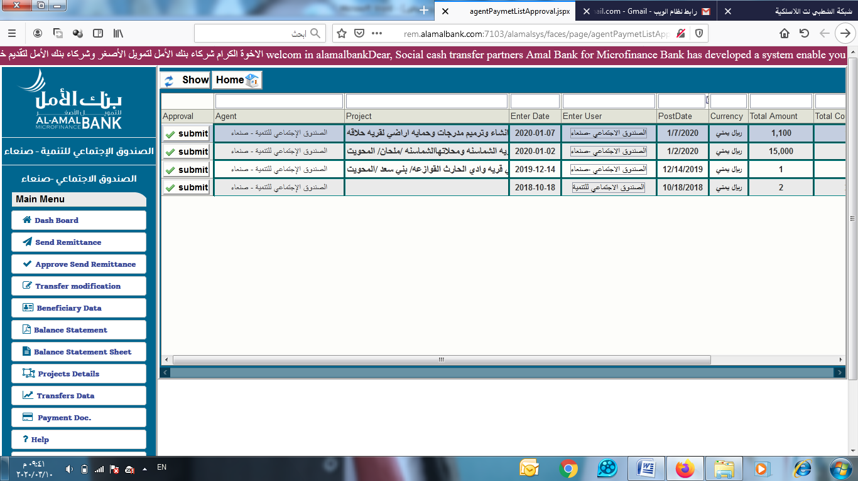
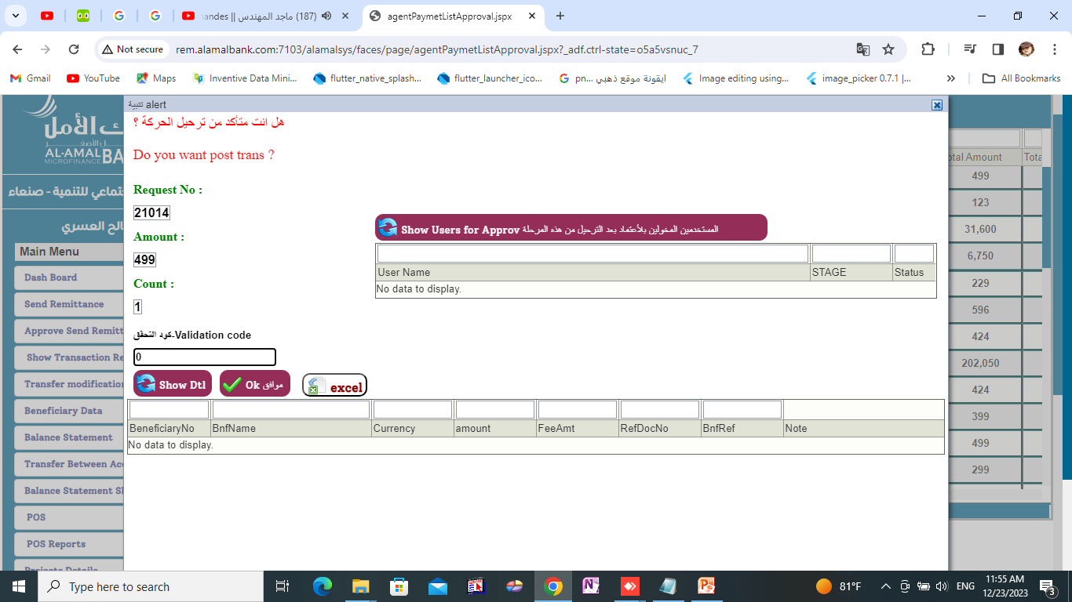
The Approve Send Remittance screen follows
After pressing the (submit) button to approve the transfers entered in the previous interface, an interface opens to display the details of the transfers to be reviewed before approval. When the OK button is pressed, a text message with the code number is sent to confirm the approval process for the person authorized to approve to be entered in the interface:
6
A small screen will appear asking him to enter the verification code that was sent to the approved phone number to complete and confirm the process of approving the transfers so that the account can be debited and the transfer number reaches the beneficiary
3
Click submit to approve the transfers
4
5
When you click on excel, the remittance statement will be exported and downloaded to the device
When you click show dtl, the details of the entered transfers will be displayed
When you click OK, a confirmation code will be sent to the approved number
View details of the entered list

Slide 11
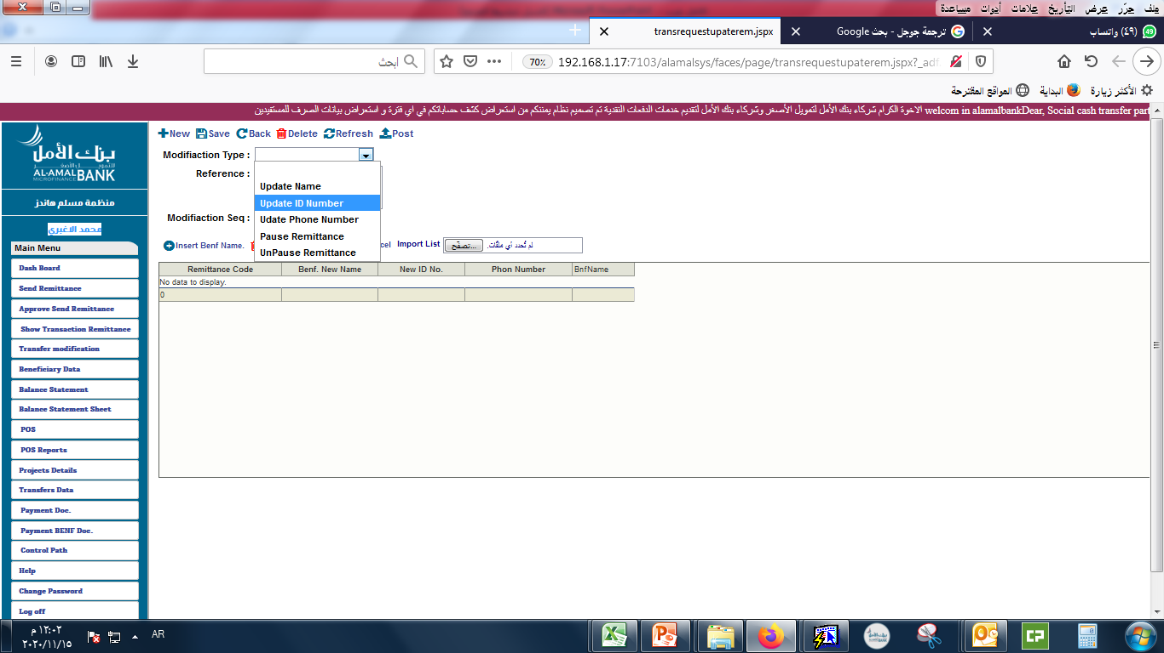
Transfer Modification Page
Through this page, any data entered can be modified: Edit name - Edit card number - Edit phone number - Stop a transfer - Remove a transfer stop
Click on the post button to transfer the transfer data
4
1
Select the field whose data you want to modify
2
The modification data is entered in the table in the field to be modified
3
Press a button save to save the modified data

Slide 12
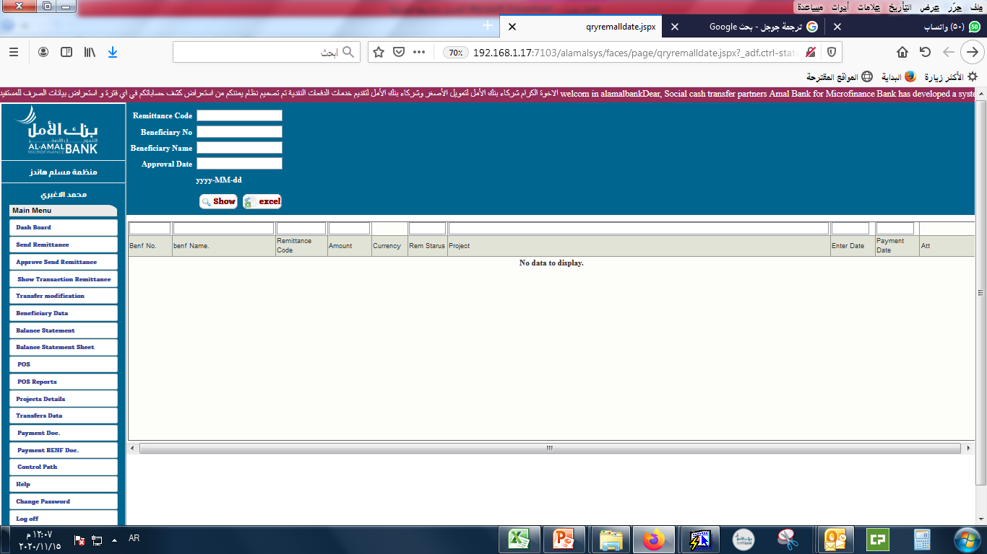
Beneficiary Data
This page enables us to search and inquire about beneficiary data through: - Search by transfer number. - Search by beneficiary number. - Search by beneficiary name.
Search in any field for which we have data such as (transfer number, beneficiary number, beneficiary name)
1
2
Click the show button The beneficiary data will be displayed

Slide 13
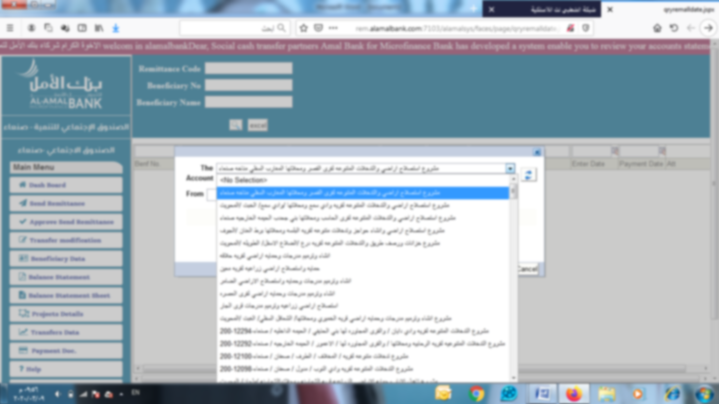
Balance Statement Page
This screen enables us to view the financial movements report by displaying all the entity’s accounts, selecting the account for which the account statement is to be displayed, then selecting from date to date to display the required report, then pressing the Print button.
1
Click on the update button.
2
Clicking on the drop-down menu button will display a list of the names of projects that have accounts
4
Specify the period in which you want to print the account statement (enter the date).
5
3
Choose the account name or project name.
Click on the Show Print button to display the account statement

Slide 14
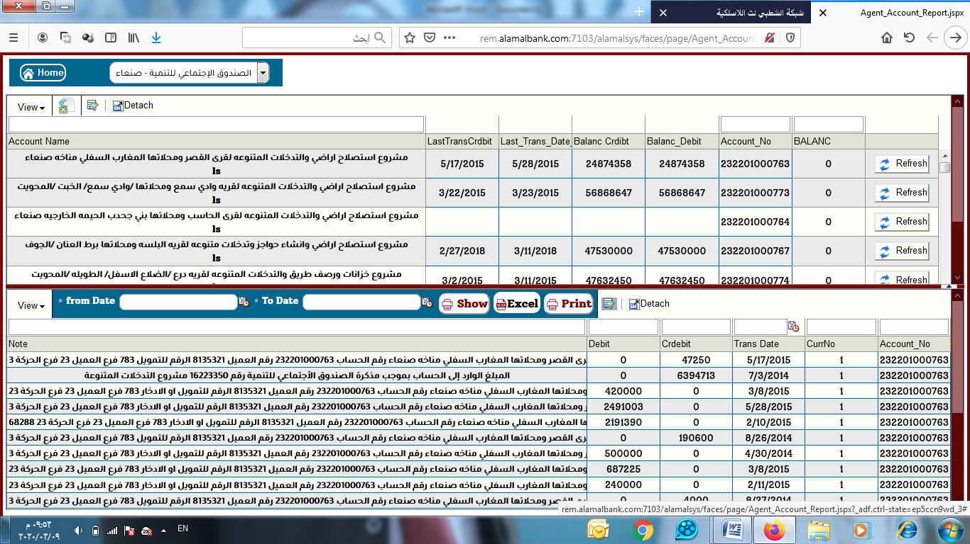
Balance Statement Sheet Page
This page enables us to view the accounts, know the total balances, and print the statement of any account that we want to print. It is the same as the previous screen, but it shows the totals.
Select the agent o view all its projects
1
All projects will be displayed with their associated accounts when you select an account
2
4
5
Click on the Show, Print, or Export button.
The start and end dates of the financial transactions to be printed
View all financial transactions for this account at the bottom of the screen.
3

Slide 15
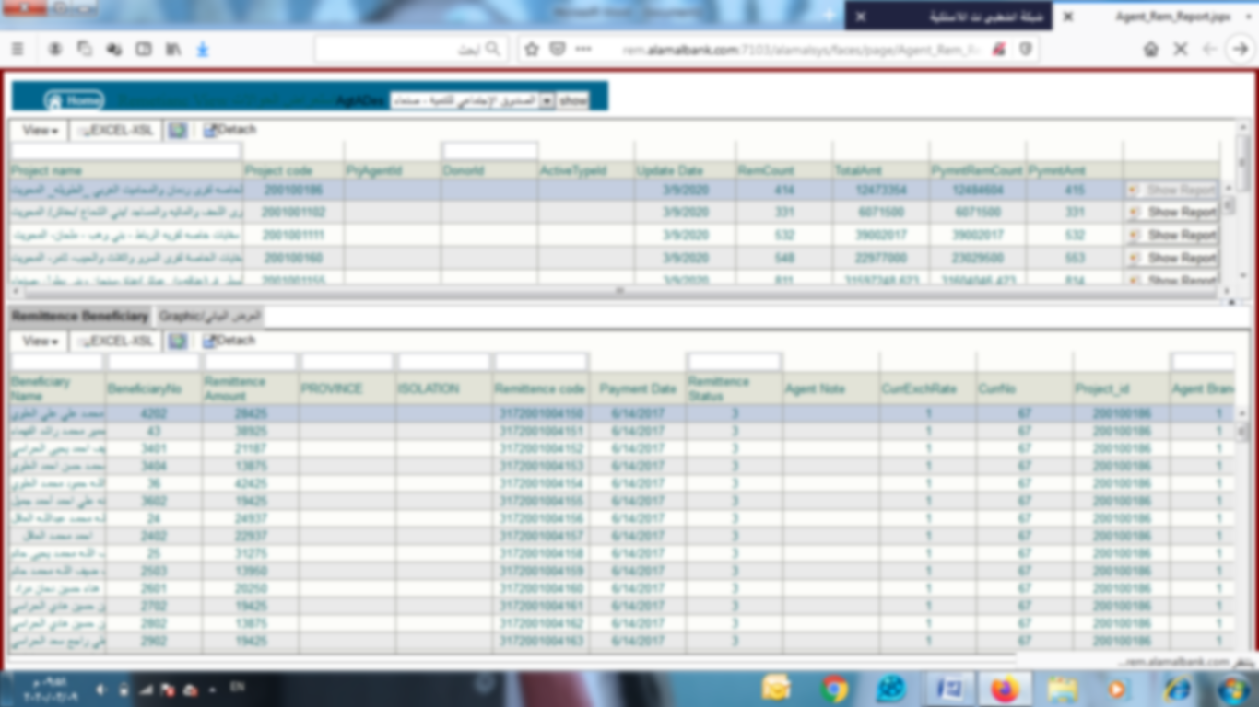
Project Details Page
This page enables us to view the projects and transfers related to each project and print a report For each project separately, it is similar to the previous page for accounts by viewing the project totals,
Select the project whose transfer report you want to view.
1
2
Click on the (Show Report) button.
Convert the report to Excel by clicking on the Excel button.
4
3
The report you want to view will appear.

Slide 16
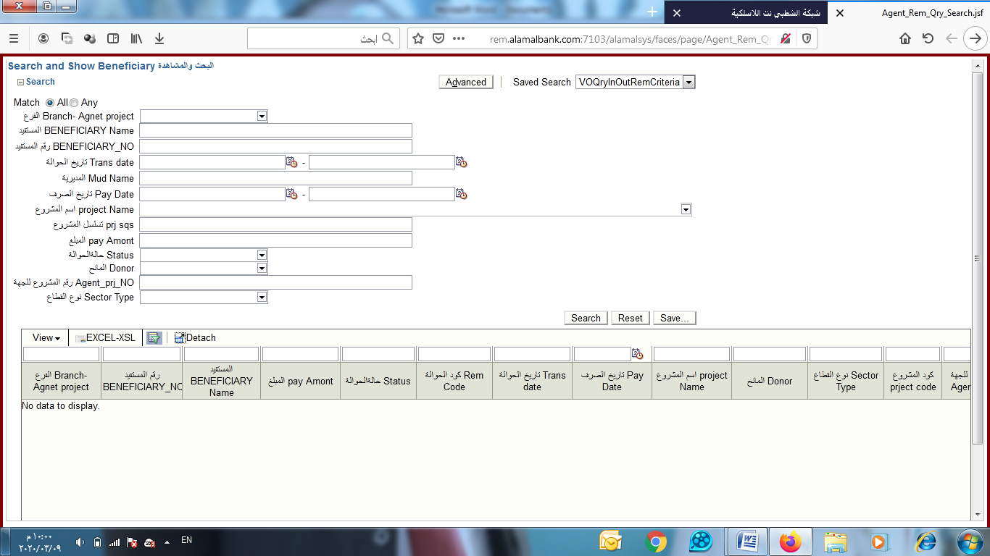
Transfer Data Page
This screen enables us to view the data of any transfer by searching in any field in which we want to search, whether the branch, beneficiary number, beneficiary name, or any other data mentioned.
1
Search by branch number
Search by beneficiary number
Search for the transfer issuance date by choosing the start date and end date
Search in one of the other fields
3
2
Convert the report to Excel by clicking on the Excel button.
A transfer report will be displayed

Slide 17
.Payment Dec Page
This Page enables us to view the exchange documents, and the contents of the screen can be viewed through the following:
2
Enter the transfer number, or import the transfer list according to the transfer number by clicking on the (Import List) button.
1
Click on the Add button.
The documents will appear in the special screen to the right of the screen, from which they can be downloaded by clicking the (Download) button.

Slide 18
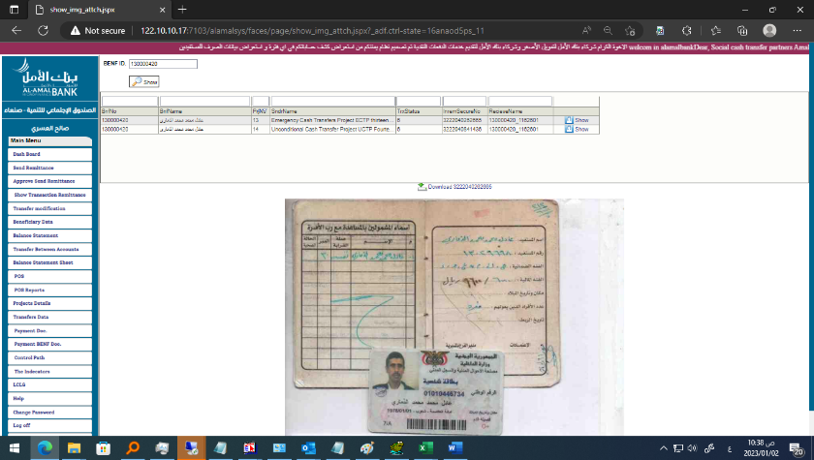
Page .Payment BENP Dec
This page enables us to view the disbursement documents, by entering the beneficiary number to view all disbursement documents to the beneficiary
1
Enter the beneficiary number
3
The documents will appear on the page and can be downloaded by clicking the (Download) button
2
Click on the Add button.

Slide 19
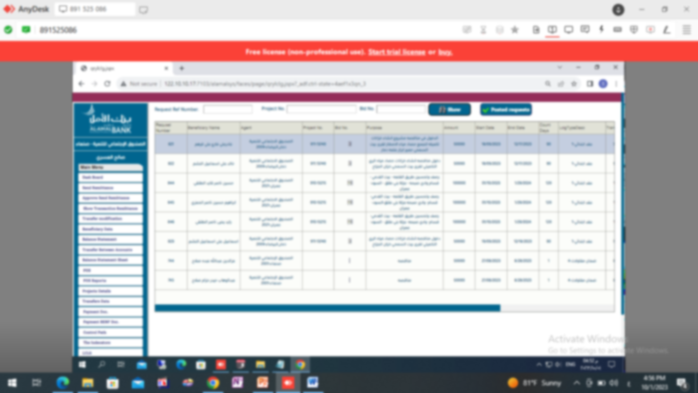
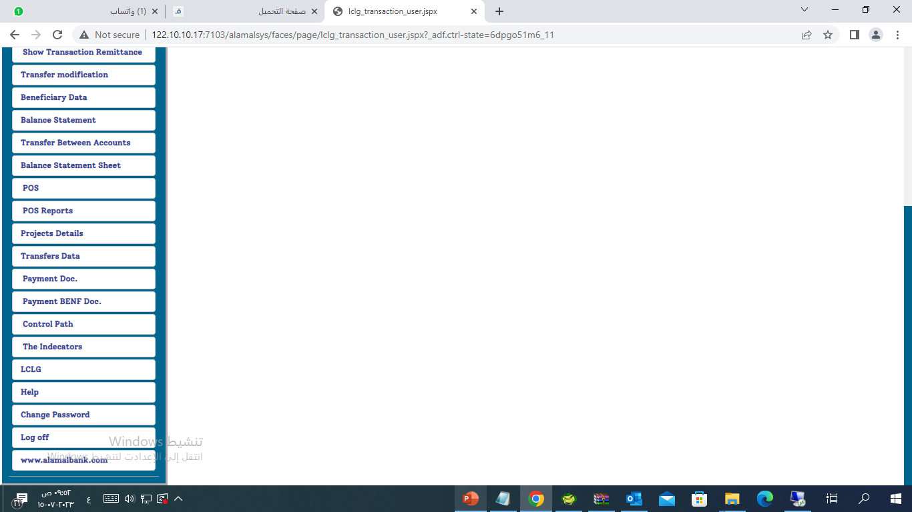
View electronic letters of guarantee (.LCLG)page
This page enables us to view the entity’s electronic letters of guarantee
Search in one of the following fields (letter of guarantee number, project number, or order number)
1
1
Click on show to display all letters of guarantee
3
Click on Indicators for arranging the numbers of letters of guarantee either ascending or descending
All letters of guarantee posted for approval are displayed
2

Slide 20
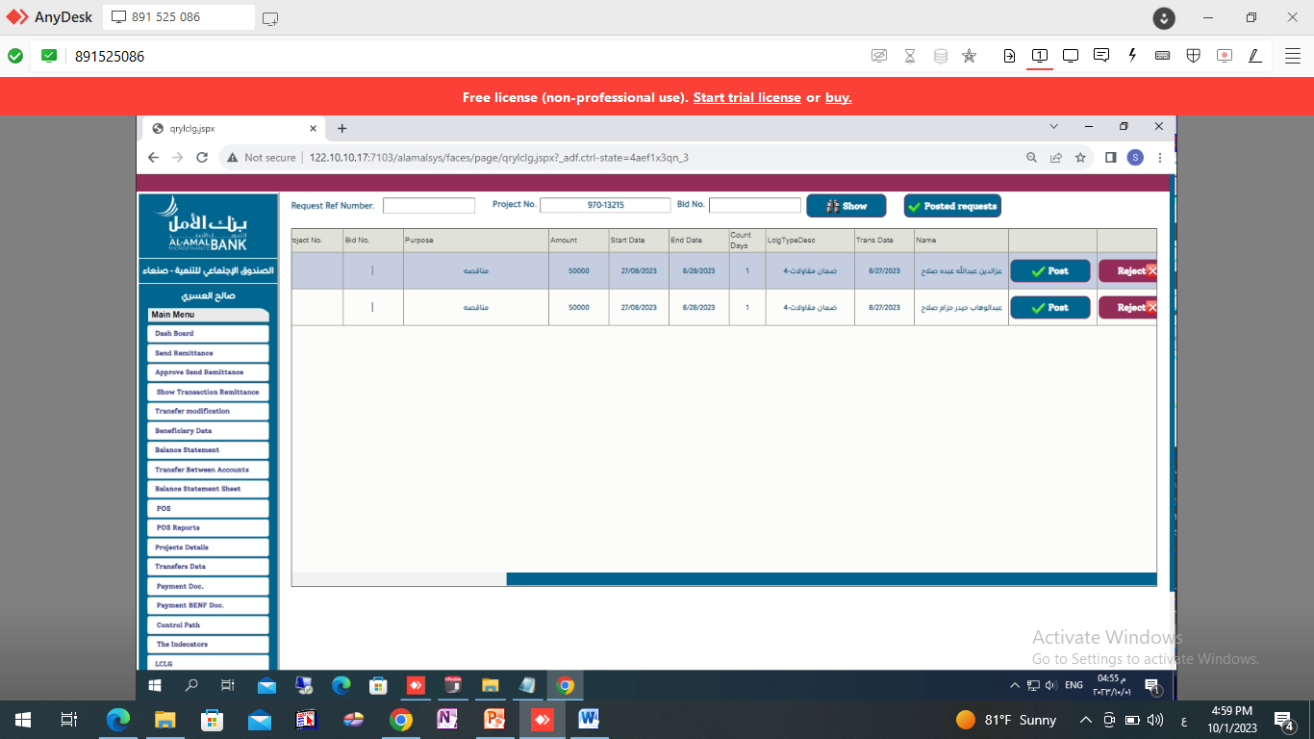
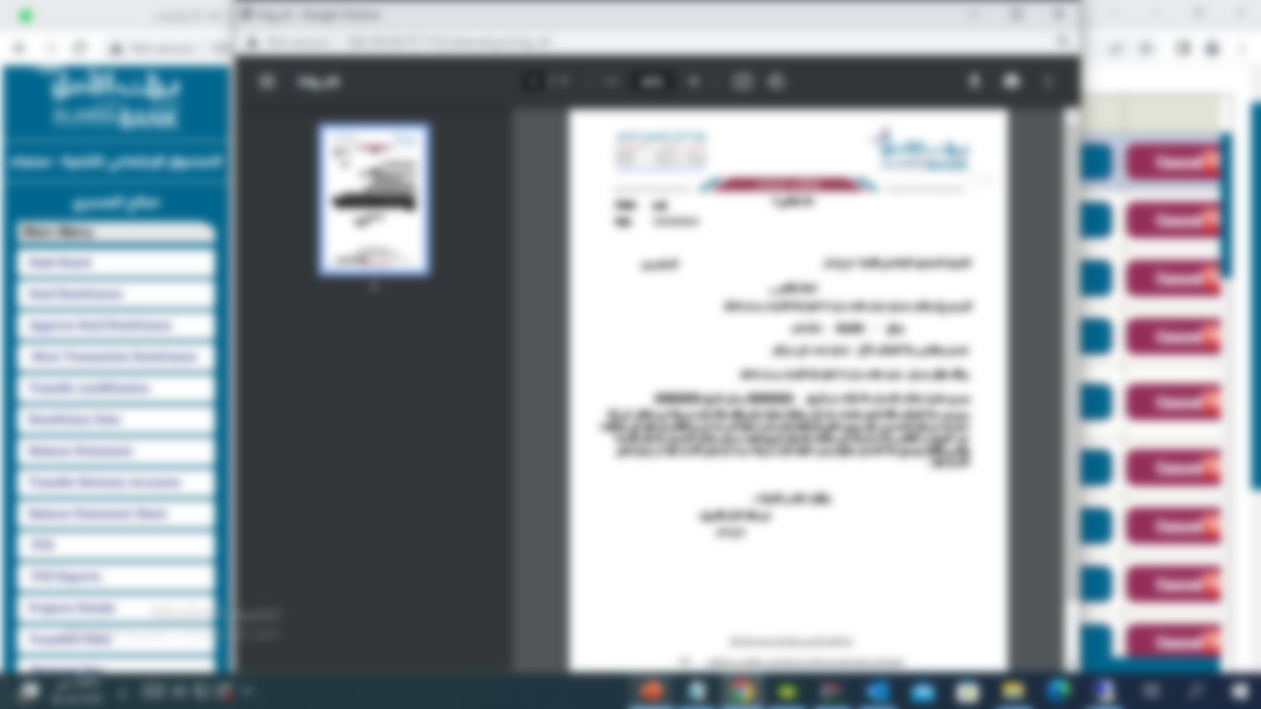
View electronic letters of guarantee (.LCLG)page
Click print To print the contract document, the letter will be transferred to the approval interface after printing
4
Click on Cancel To cancel the letter if there is no approval
5

Slide 21
Electronic letters of guarantee approval screen (LCLG).
1
Click on Approved button requests

Slide 22
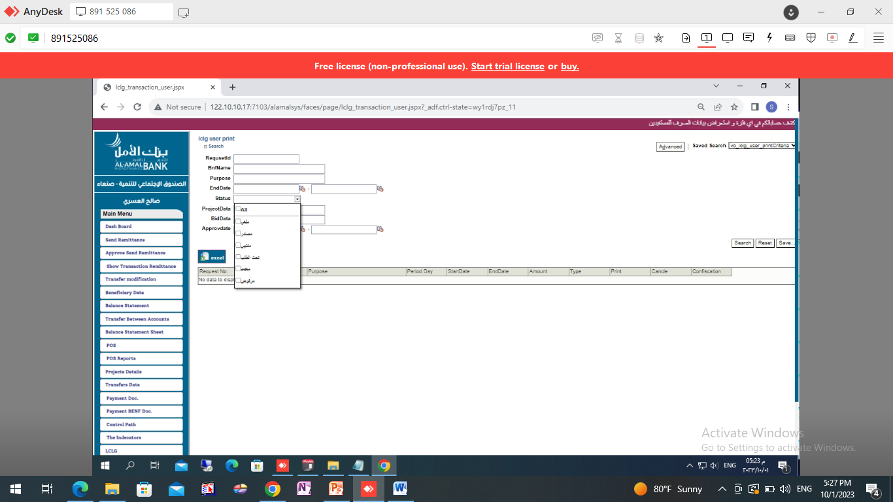
View the Electronic Letters of Guarantee (.LCLG) approval page.
Search by name of the letter of guarantee provider
2
Search for the purpose of letter of guarantee
Search for the printing date of the letter contract
3
Search for the project closing date
Click on search
button
Search by letter amount
Search by speech status
Click the Reset button to filter the search options

Slide 23
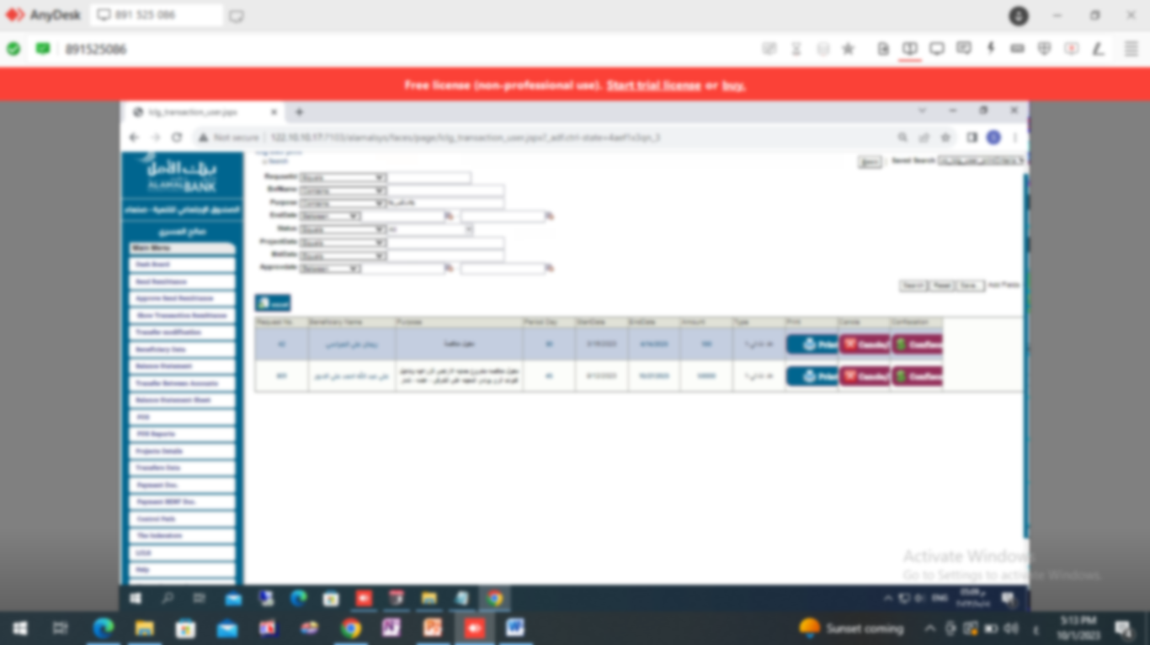
Advanced search in the Electronic Letters of Guarantee (.LCLG) approval page.
2
Specify the processes you want to search by
1
3
Click on Advance to display advanced search options
Search by one of the specified fields
4
Click on search to view the search results
4
The letter will be displayed

Slide 24
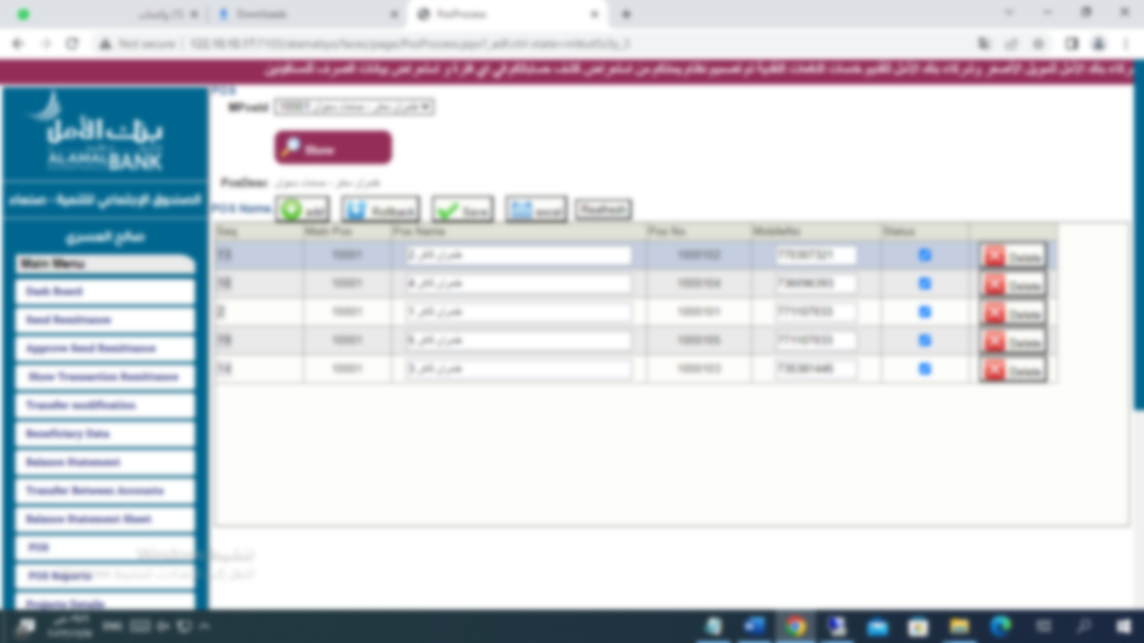
Point Of Sale Page
(pos)
This page enables us to view point-of-sale data for paying purchases, as it enables the entity to review all its sub-points of sale.
1
Choose your main selling point from the list
2
Click on show
Sub-points of sale subordinate to the main point of sale are displayed
3

Slide 25
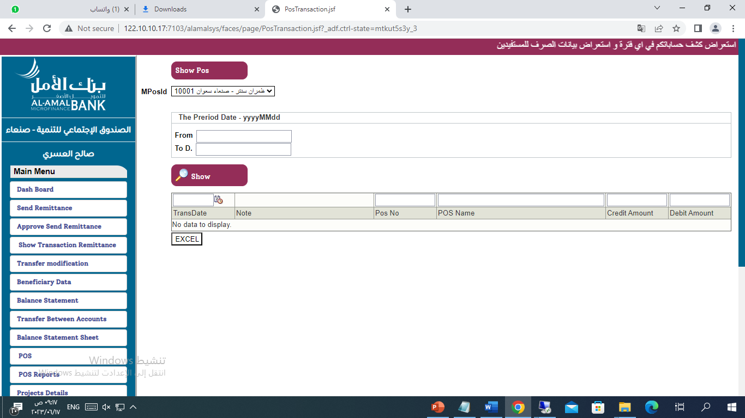
Pos Reports Page
This page enables us to view the report on the financial movements of the points of sale for paying purchases, as it enables the entity to review all the financial movements of its sub-points of sale.
1
Click on the show Pos button
2
Choose the main point from the list
3
Specify the start and end date for the report to be displayed
4
Click on the show button
5
6
All POS transactions during the selected period are displayed
Press the Excel button To export all movements to an Excel file

Slide 26
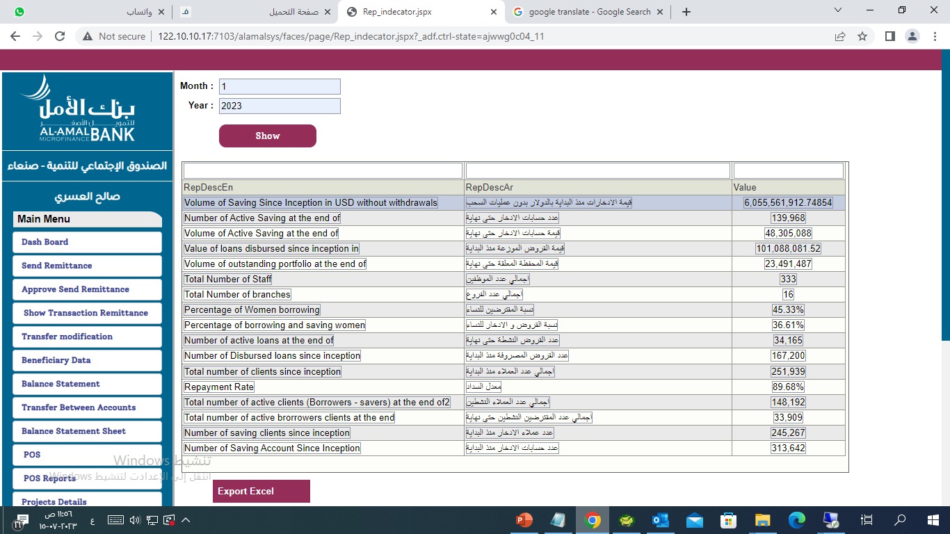
The Indicators Page
1
Add month
2
Add the year
Click on the show button
Details of the desired report are displayed
3
4
Click on Export Excel button to export the report to an Excel file

Slide 27
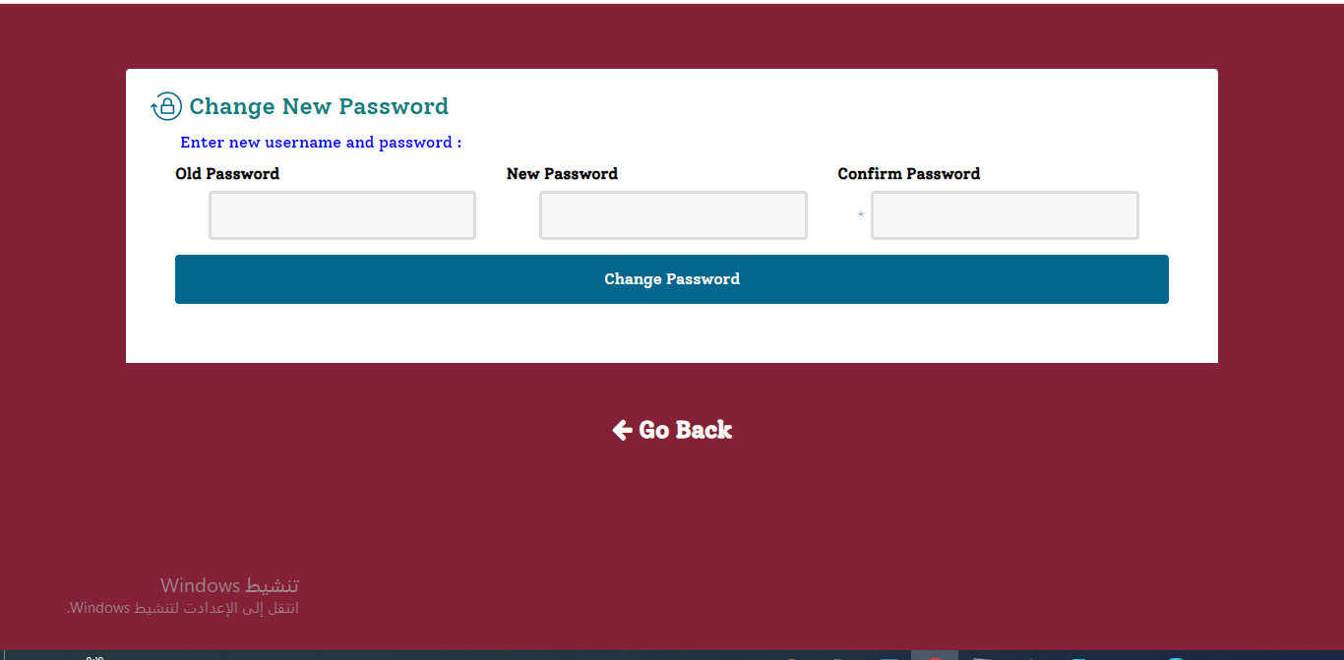
Change password page
This feature enables you to change your password by entering the old password and then the new one, and you must repeat the new password twice to make sure it is correct. All requirements must be filled out, otherwise a warning message will appear informing you that one of the items has not been entered.

